Slide 1
FAQ COLLAPSE
By Timothy Ndichu ENE212-0076/2017

Slide 2
WHAT IS THAT?
1
Let’s start by defining what an FAQ Collapse is, its origin and where it is used

Slide 3

FAQ
FAQ stands for Frequently Asked Questions and is a list of questions and answers relating to a particular subject, especially one giving basic information for users of a website.

Slide 4
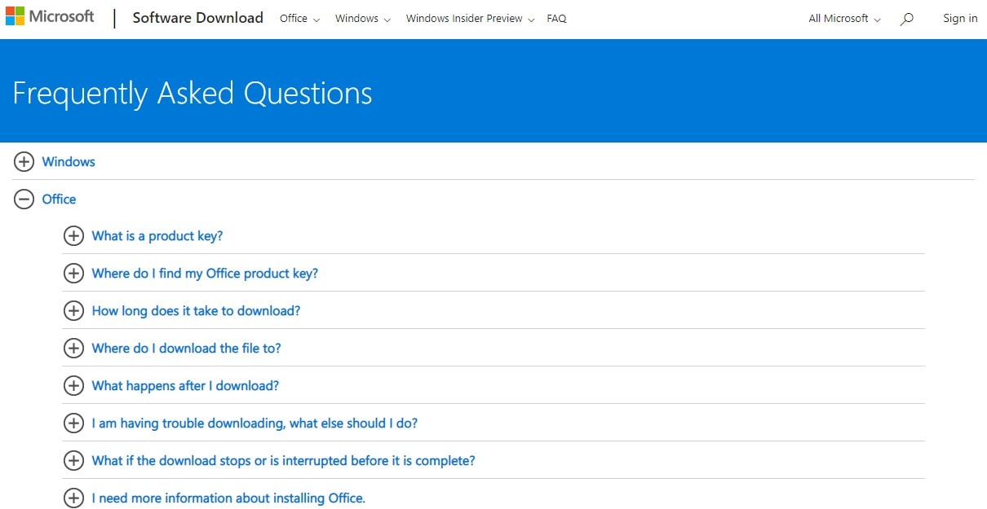
FAQ Example

Slide 5
Accordion
Another term for “FAQ Collapse” is Accordion.
An accordion is used to show (and hide) HTML content.

Slide 6
WAYS TO IMPLEMENT IT
2
Here we will look at the various ways to create accordions

Slide 7
Bootstrap
Bootstrap is a free and open-source web development framework. It’s designed to ease the web development process of responsive, mobile-first websites by providing a collection of syntax for template designs.
One can build vertically collapsing accordions in combination using the Collapse JavaScript plugin which is integrated within Bootstrap.
One needs to simply add “accordion” to the class attribute of a div and define the accordion-items within that div.

Slide 8
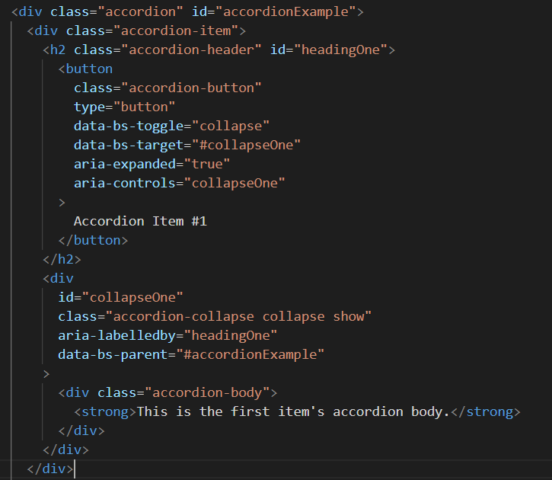
Bootstrap
data-bs-toggle: assigns an action
data-bs-target: the div we want to collapse
data-bs-parent: accepts a CSS selector to apply the collapse to
aria-expanded: indicate if a control is expanded or collapsed, and whether or not its child elements are displayed or hidden.

Slide 9
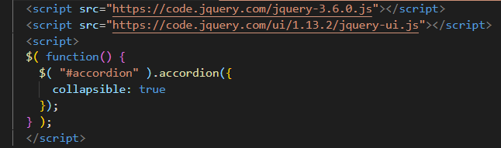
JQuery
jQuery is a lightweight, "write less, do more", JavaScript library.
The purpose of jQuery is to make it much easier to use JavaScript on your website.
We can accomplish creating our accordions using the pre-defined accordion method within the Jquery library.

Slide 10
Basic HTML, CSS, JS
You can use HTML, CSS and JavaScript to create a stylish and dynamic accordion menu.

Slide 11
DEMO
3
Here we will see the FAQ Collapse in Action

Slide 12
THANKS!

